Slide 1

SAP Build Training for Corporate Professionals
DAY-1
www.anubhavtrainings.com

Slide 2


DISCLAIMER
The training content and delivery of this presentation is confidential, and cannot be recorded, or copied and distributed to any third party, without the written consent of Anubhav Trainings

Slide 3

Introduction
Welcome to the BTP Build Training Course, specially designed for SAP functional and technical Consultants helping to design and develop processes and apps
The Course is designed to provide end to end development on SAP Business Technology platform with SAP Build offerings that include Both build apps and build process automation.
www.anubhavtrainings.com

Slide 4
Agenda
Who is this course for
Mapping the developer persona with the training
SAP BTP
Introduction to SAP BTP platform and its offerings
Hands-on
Setting up SAP BTP Trial account and understanding services
Services
Exploring various SAP BTP Services and understanding BTP environments

Slide 5





Who is this course for
Abramo
SAP Solution Architect
How SAP Build process automation on BTP can help to best fit to organizational needs
Vladía
SAP Process Expert
Understanding key capabilities around SAP Build process automation
Zakir
SAP developer
Build and deploy end to end applications with low code and no code tooling
Kelly
Functional Consultant
How to transform key requirements into integrated flow of applications and processes in cloud connected to on-premise systems

Slide 6






Expectations
01
02
03
04
05
SAP BTP
Understanding SAP BTP and Setting up Account
SAP Build
SAP Build portfolio and Services for BPA and Work Zone
Process Authoring
Create end to end build business processes with decisions and forms
Build Apps
Create Apps using LCNC drag-drop based tooling capabilities
Deploy and manage
Understanding deployment and delivery of process and apps using CICD
6

Slide 7
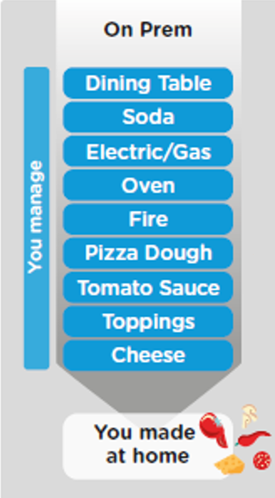
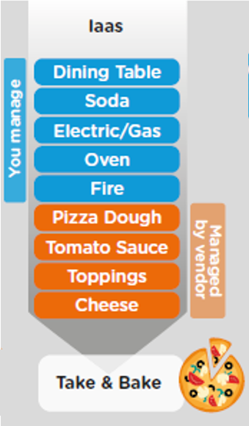
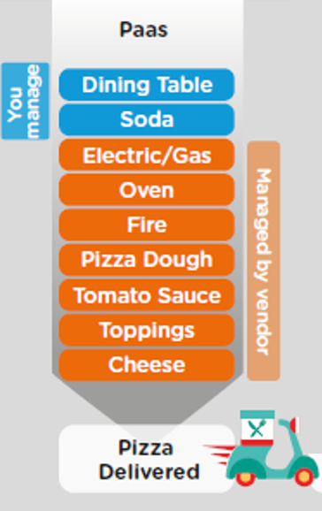
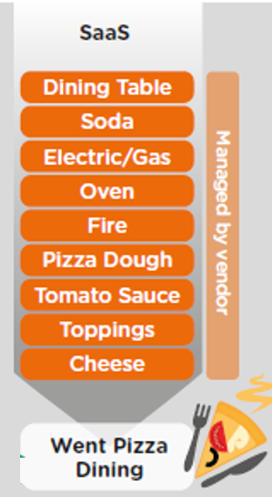
Difference between On-premise and Cloud system

Slide 8


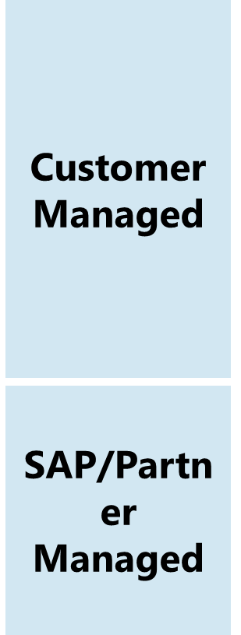
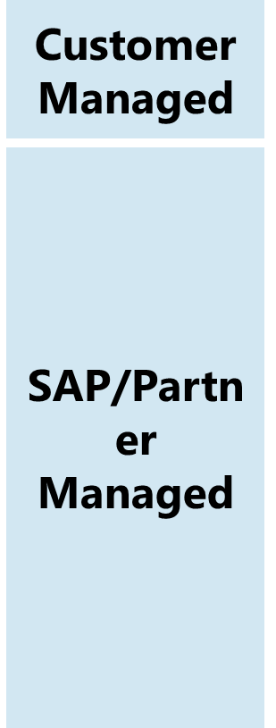

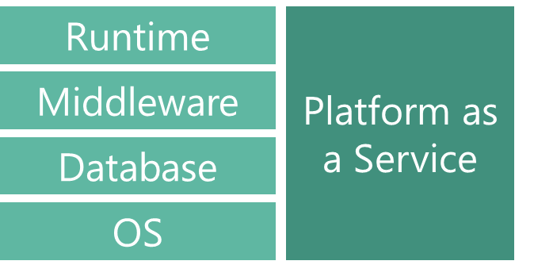
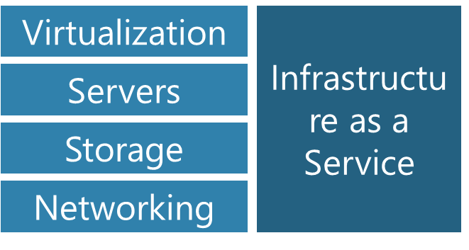
What are the cloud offerings?

Slide 9
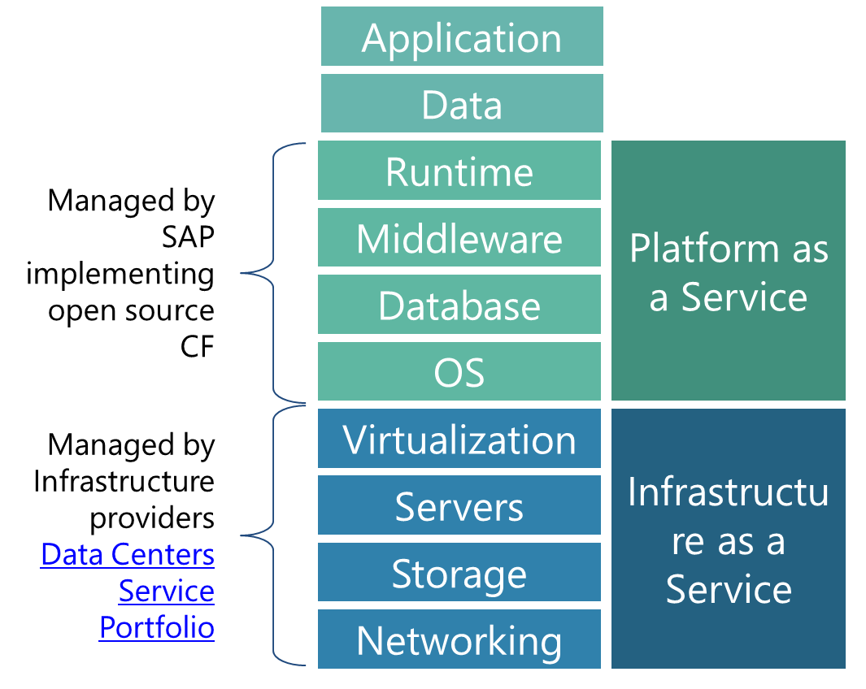
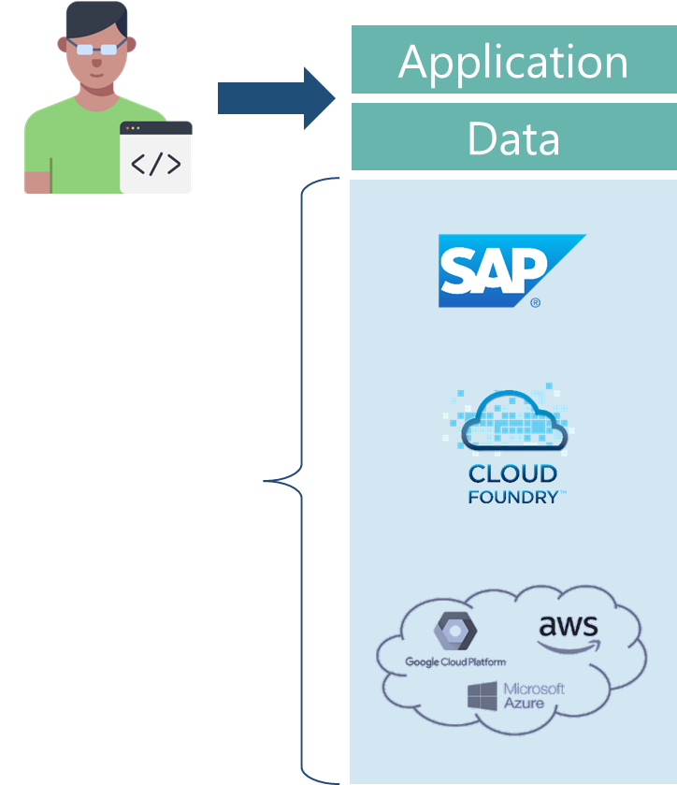

What is BTP and advantage?
Fully ready landscape with reusable services
Scalability
Elasticity
Low TCO

Slide 10















Slide 11
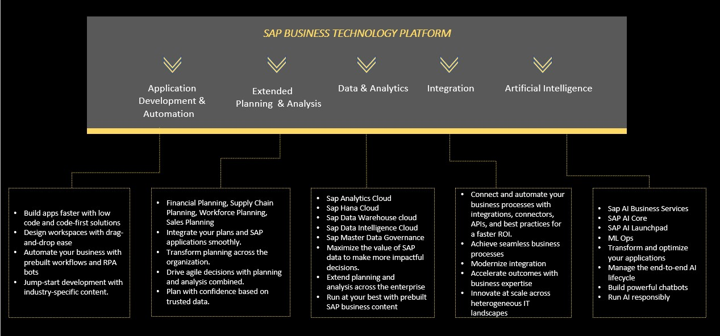

SAP BTP portfolio offerings
Development using visual low-code, no-code experience
Pro-code end to end application development using CAPM and RAP
Digital Experience using work zone
Dev Ops using CTMS and CICD Services
Process authoring and Automation using SAP Signavio and SAP Build BPA
sphere

Slide 12
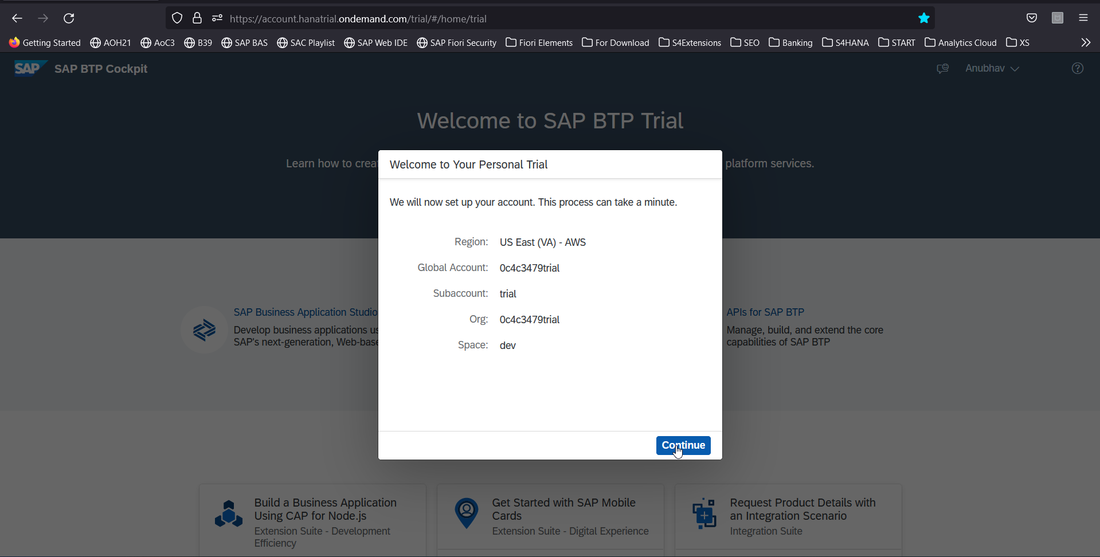
Let’s Create a BTP Account
Create your free BTP Account
https://account.hanatrial.ondemand.com/trial/#/home/trial
What is BTP?
BTP stands Business technology platform, it is a PaaS in the cloud provided by SAP to design, develop, package, build, deliver and manage applications, integrations and business process automation.

Slide 13
BTP Account Structure
Backing Services
Global Account
(Representation of customer for billing purpose)
Sub Account
(per region)
Specialized service offerings
Represents LoB
Space quotas
1 *
1 *
Space
1
*
Apps

Slide 14
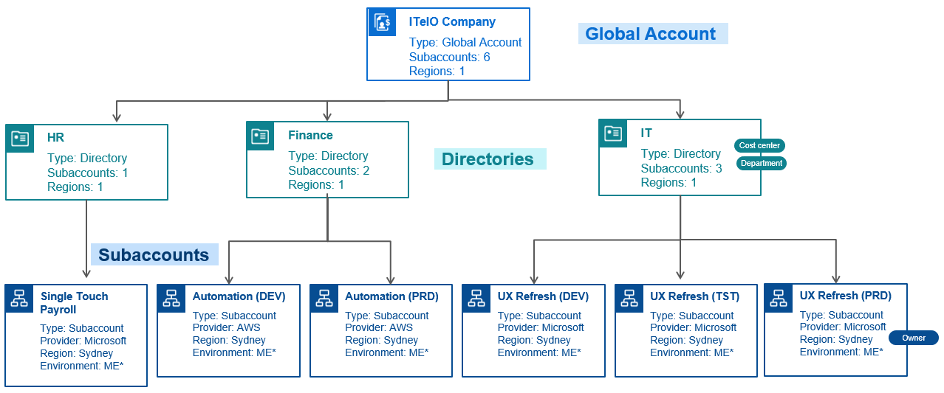
BTP Account – Administrator’s view

Slide 15
BTP Environments, Subscriptions, Instances
Environments
Environments constitute the actual platform-as-a-service offering of SAP BTP that allows for the development and administration of business applications. Environments are anchored in SAP BTP on subaccount level.
SAP BTP offers three environments: ABAP, Cloud Foundry and Kyma. Some existing customers still have Neo, but this is no longer offered.
Subscription based services
You will also see these ones called software as a service (SaaS), or multitenant applications. The experience here is that you subscribe to the service, and in return you receive a URL, from which you can access that service. Opening the URL brings you to a web application from which you can leverage the service. This is how other SaaS like SuccessFactors or S/4HANA Cloud work as well. They are also enabled at a subaccount level, and are independent of the environments. You don’t need to have Cloud Foundry enabled to subscribe to SAP Launchpad Service, for example.
Examples include Launchpad, SAP Business Application Studio, Cloud Integration, Process Automation…
Instance based services
These are the purest services. They provide a specific functionality, like databases, connectivity, authentication…. You connect your application to them to leverage that functionality. These services don’t provide a UI to manage them. Instead, they rely on API to connect to applications and other services and provide their services. They are provisioned inside an environment, so they are environment specific. Each environment has its own organization (for users and applications): In Cloud Foundry, instances are created inside a space. For Kyma, instances are created inside a namespace.

Slide 16
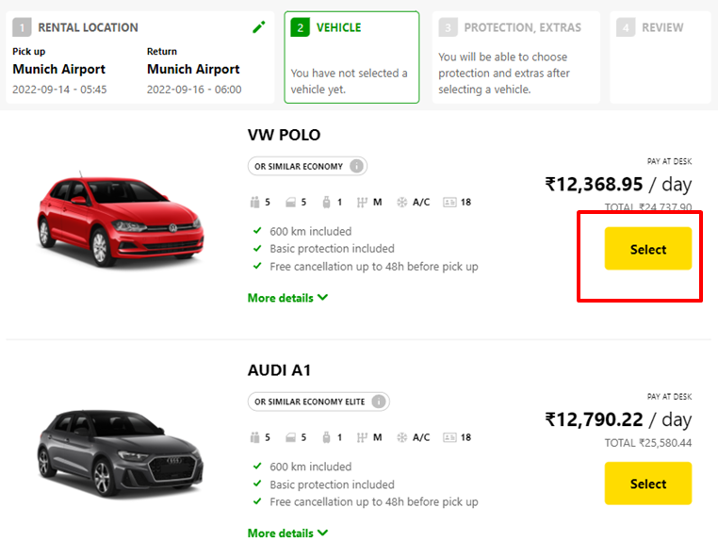
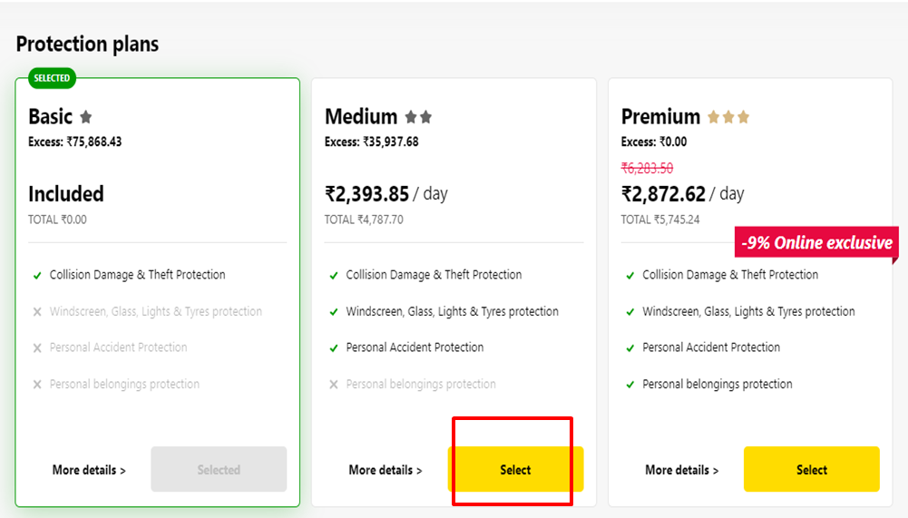
What is Backing service/ service instance
Each service has one or more service plans available. A service plan is the representation of the costs and benefits for a given variant of a particular service. For instance, a database may be configured with various "T-shirt sizes", each of which is a different service plan.
Choose Your service
Backing Service
Select Plan
Service Plan

Slide 17


How the Instance work?
Car key to use Car
Service Key to Consume Service instance
Actual Car
Service Instance

Slide 18
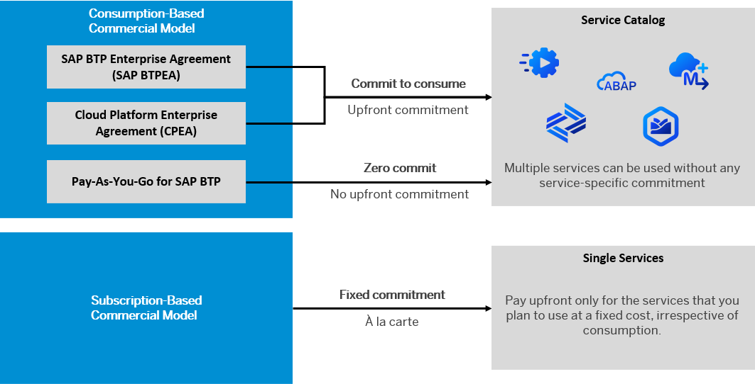
BTP Subscription Models

Slide 19
How many Services BTP offers?
The SAP Discovery Center is a relatively new site hosted by SAP for developers and architects to find the services hosted by sap in SAP BTP and their respective service plans available.
It will also help technical team to identify the data center availability and cost associated with each service.
https://discovery-center.cloud.sap/#/serviceCatalog

Slide 20

What We Did
Let’s Summarize
www.anubhavtrainings.com

Slide 21
www.anubhavtrainings.com
Thank You
End of Day 1
www.anubhavtrainings.com

Slide 22


We’re committed to empower you to be
#FutureReady
through powerful training solutions.
We build the workforce of the future.
250+
Corporate Clients
30,000+
Learners Trained
25000+
Learners Placed
FREE WEBINARS
Sign up for free webinars with industry experts every fortnight!
Enroll Now!
Contact us today!
https://anubhavtrainings.com

Slide 23
<content>

Slide 24
Thank You
www.anubhavtrainings.com

